Slide 1
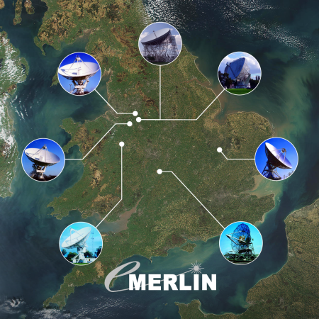
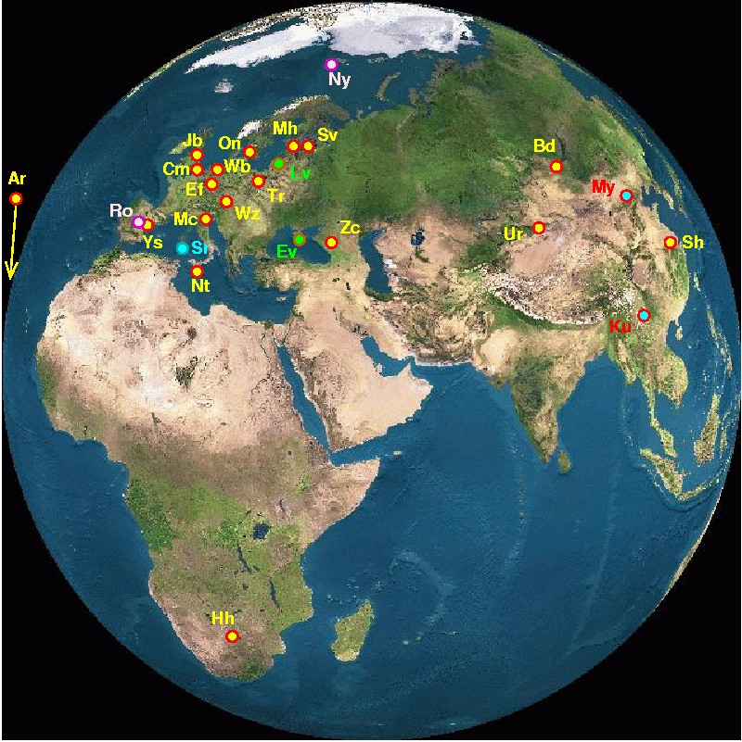
Prospects for e-Merlin – EVN
Tom Muxlow JBCA / JBO
Jumping JIVE – VLBI Futures Meeting
Zaandam, the Netherlands 1st March 2018
EVN

Slide 2
Prospects for e-Merlin – EVN
Outline:
e-Merlin – Description, recent developments, and planned new facilities
– Science-driven upgrades
– Unique spatial frequency coverage at cm-wavelengths
– e-Merlin + EVN – Combination imaging
– e-Merlin + EVN + Goonhilly
– The CUGA consortium
– e-Merlin + EVN – Delivery…
– e-Merlin + EVN – In the SKA Era (e-MERGE + EG078)
DQSO
e-Merlin 5GHz

Slide 3
e-Merlin – Unique spatial frequency coverage at cm-wavelengths
– A dedicated compact VLBI imaging array
Deep high-resolution imaging of well-known radio structures leading to new discoveries….
DQSO
VLA 8GHz
e-Merlin contours
HST false colour
DQSO
e-Merlin 5GHz
Optical synchrotron from jet interaction – or jet-induced star-formation?

Slide 4
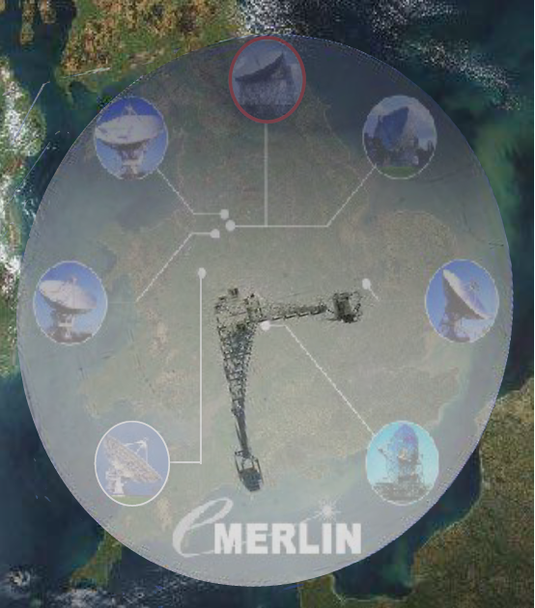
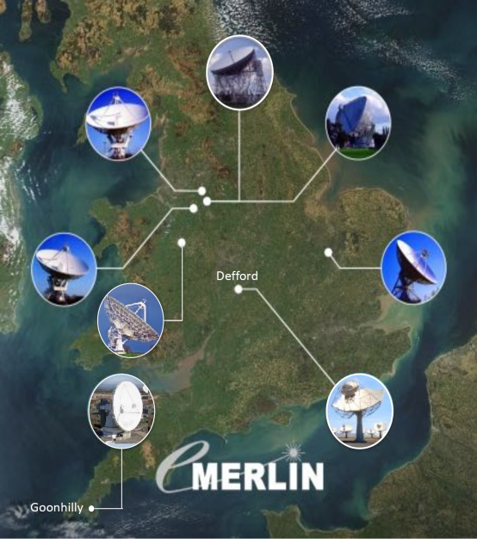
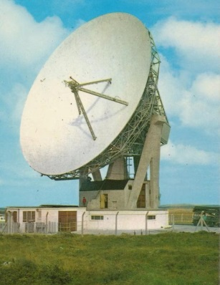
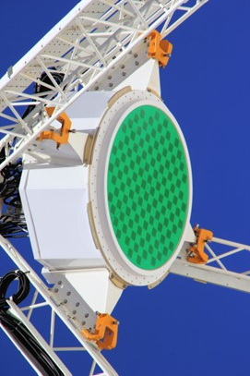
e-Merlin – Recent improvements and planned new facilities
On-going Operational upgrades
Final commissioning of 2GHz bandwidths (C/K-band)
Phasing up of array – sensitive PSR/transient instrument ~equivalent to 110m dish
Inclusion of new dishes – Goonhilly + others? – More resolution, more uv coverage
Lovell Telescope: New elevation encoder and ASKAP PAF
e-MERLIN fully integrated into EVN → baselines from 10 to 10,000 km

Slide 5
e-Merlin – Recent improvements and planned new facilities
On-going Operational upgrades
Final commissioning of 2GHz bandwidths (C/K-band)
Phasing up of array – sensitive PSR/transient instrument ~equivalent to 110m dish
Inclusion of new dishes – Goonhilly + others? – More resolution, more uv coverage
Lovell Telescope: New elevation encoder and ASKAP PAF
e-MERLIN fully integrated into EVN → baselines from 10 to 10,000 km
Funding confirmed for further 5 years
New SDP-like software pipelines – look, feel, & behave like SKA
~20% increase in operational funding
Ambitious cost-effective planned upgrades – noted, but awaiting future funding
New frequency bands – S-band & X-band (SKA Band 5b)
Cyro-PAF (S- or L-band)
Replacement of Defford telescope (with SKA1-mid dish) – allow better performance at >~6GHz
Digital upgrades → increase bandwidths

Slide 6
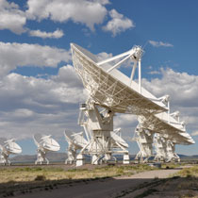
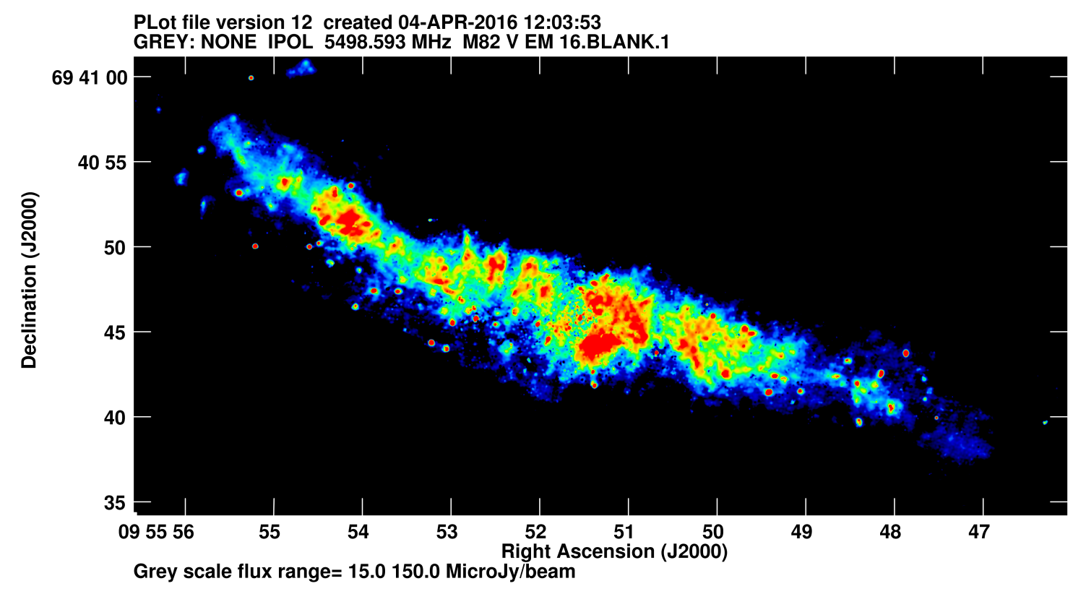
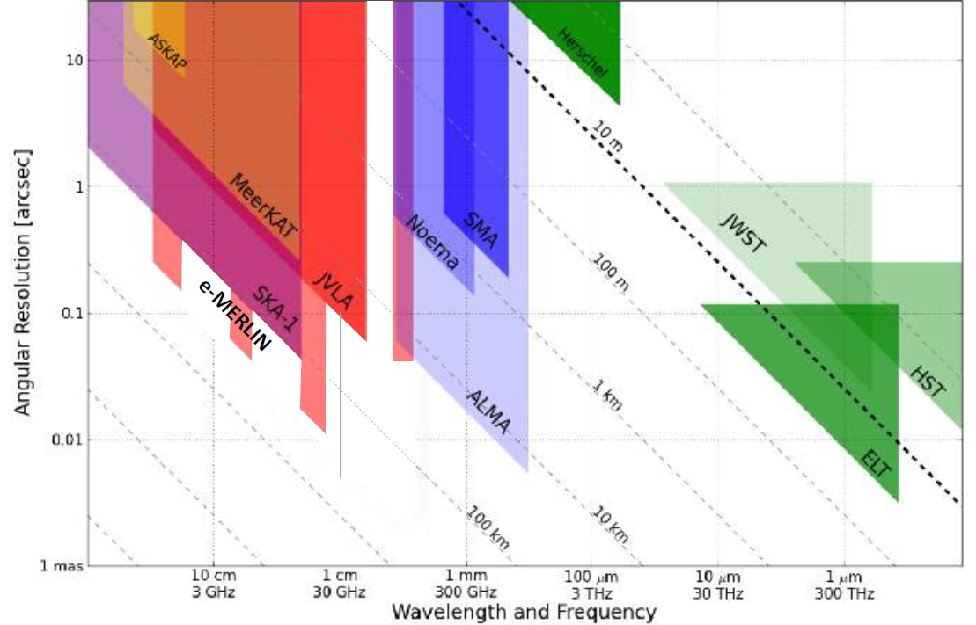
e-Merlin – Unique spatial frequency coverage at cm-wavelengths
e-Merlin with baselines from 10km – 220km provides imaging capability covering a unique range of spatial scales overlapping with the JVLA at lower angular resolution and extending up to the EVN with ultimate angular resolution < 1mas
In addition to being a dedicated compact VLBI imaging array, e-Merlin is used in combination with the JVLA for increased angular resolution whilst retaining superb surface brightness sensitivity
M82 – e-Merlin + JVLA 5.5GHz
Beam: 96mas
EVN
Argo+ 2016A&G…57c3.36A

Slide 7
e-Merlin – Unique spatial frequency coverage at cm-wavelengths
e-Merlin with baselines from 10km – 220km provides imaging capability covering a unique range of spatial scales overlapping with the JVLA at lower angular resolution and extending up to the EVN with ultimate angular resolution < 1mas
…and in combination with the EVN to provide short-spacing coverage to the EVN to place the mas-scale VLBI images in context with regard to any extended radio structure present.
EVN

Slide 8
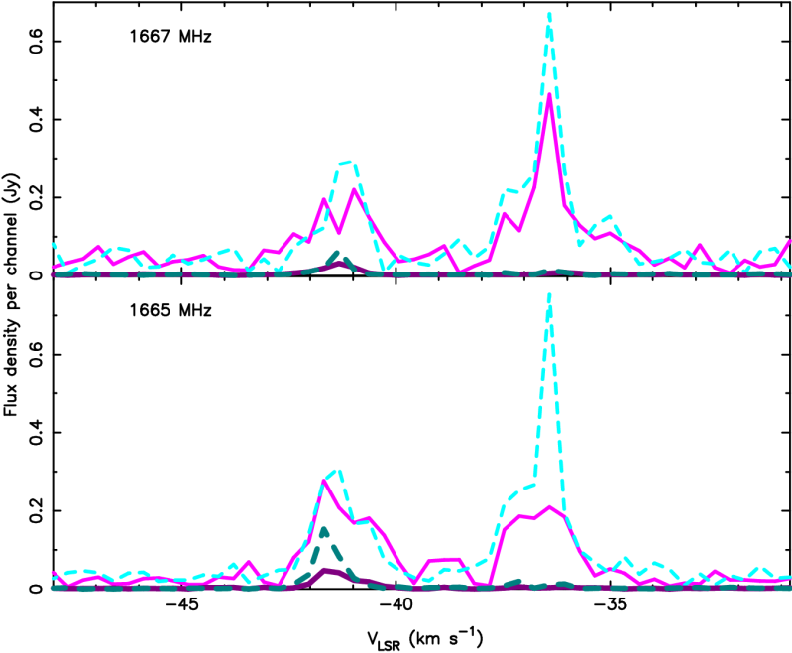
e-Merlin + EVN
The Intermediate baselines for high fidelity imaging at angular resolutions between e-Merlin and the EVN – Long promised but finally on the way !!
Galactic stellar evolution: Maser Emission in U Orionis – Richards+ (2008)
Main requirements for investigating mass loss mechanisms and wind driven material from evolved stars are: Good baseline coverage (image fidelity) from tens to hundreds of kms (thousands at L-band)
→Sample all scales from a (few) hundred mas (depending on frequency) down to ~1 mas.
→Higher resolution valuable for very rapid proper motion studies, & avoiding beam depolarization.
To image masers and place them within their environments:
H₂O: Ideally want baselines in the range 10 → 500kms
OH: Ideally want baselines in the range 40 → 2000kms
Merlin
EVN
U Orionis – OH masers
Separate Merlin and EVN images
OH masers observed by EVN and Merlin within a few weeks (1998)
EVN heavily resolves the masers, virtually unresolved by Merlin
LL and RR plotted

Slide 9
e-Merlin + EVN – Combination imaging
The Intermediate baselines for high fidelity imaging at angular resolutions between e-Merlin and the EVN – Long promised but finally on the way !!
Extragalactic star-formation: The Radio Core Structure in NGC4418 – Varenius+ (2014)
Inverted spectral index α ≥ 0.7 (S _{ν} ∝ ν^{α}) for the compact regions of radio emission.
T_{B} >10^{4.8} K indicate that these compact features cannot be HII-regions.
→ 8 Super star clusters (intense star formation) with associated free-free absorption (A→H) → Low radio-to-IR ratio of the nucleus.
Separate Merlin and EVN C-Band datasets – Merlin + combination
Images at intermediate resolution to study individual star clusters.
Image fidelity can be limited by lack of uv-coverage overlap
Merlin: Beam 105x42 mas
EVN+Merlin: Beam 27x20 mas
EVN+Merlin: Beam 16x11 mas

Slide 10
e-Merlin + EVN
Simulated amplitude data for e-Merlin and the Western EVN for a two Declination +60° 0.5Jy point sources separated by 9mas . Bandwidth 400 MHz
EVN simulations based on JB-Lovell, Efflesberg, Westerbork, Onsala, Noto, Torun, Medicina
e-Merlin
Klockner+ (2011)
Separately correlated e-Merlin+EVN imaging add short spacings but has very little uv-coverage overlap.
e-Merlin telescopes → EVN correlated datasets begins to populate the overlap region.
Efflesberg-Westerbork
EVN
Inner EVN

Slide 11
e-Merlin + EVN + Goonhilly
Adding Goonhilly to e-Merlin both fills in the overlap region with EVN and doubles the angular resolution of e-Merlin – and also improves image fidelity at low Declinations
e-Merlin
e-Merlin+Goonhilly
Klockner+ (2011)
e-Merlin+Goonhilly added to EVN-correlated datasets adds short uv spacings and fills the coverage holes at baselines <5M λ
EVN
Inner EVN
Heywood+ (2011)

Slide 12
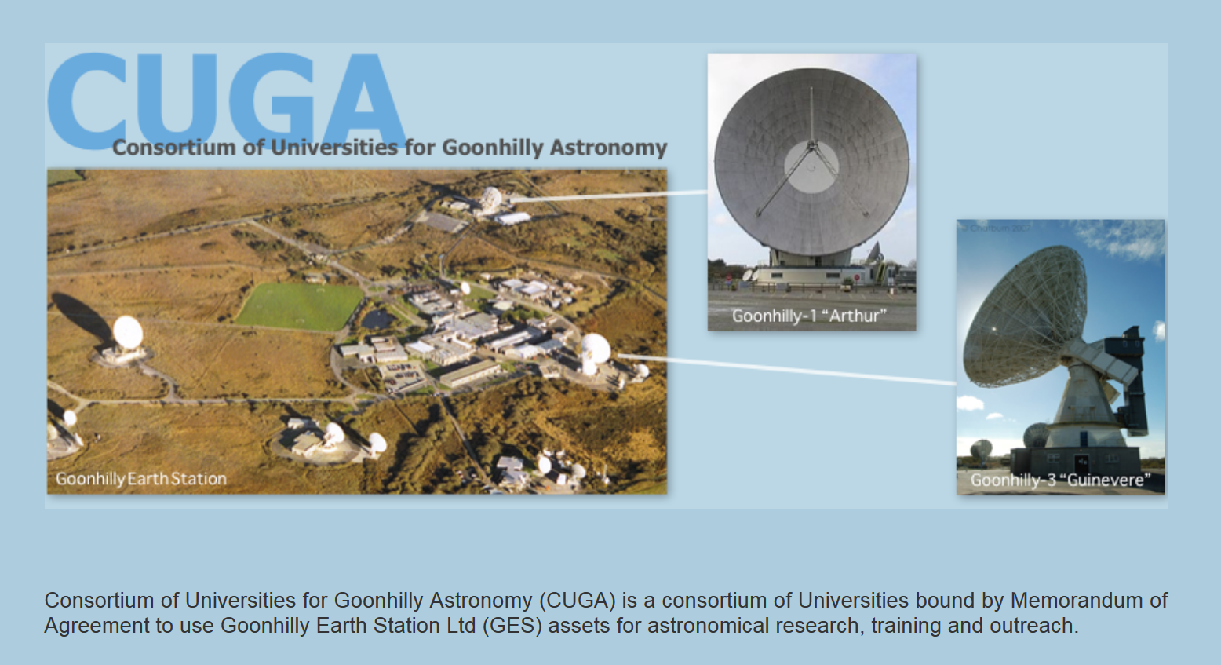
e-Merlin + Goonhilly
http://www1.ast.leeds.ac.uk/~mgh/CUGA.htm
26m L-Band
CUGA Consortium:
Leeds (Lead)
Manchester
Hertfordshire
Durham
Oxford
UCLAN
Bristol
Delivery 1-2 years (?)
30m C-Band
Envisage data transmission back to JBO for inclusion into the e-Merlin correlator – and available for recording with other e-Merlin antennas for correlation in JIVE.
Antenna duty cycle of availability and JBO returned bandwidth still being finalised

Slide 13
e-Merlin + EVN
Delivery…
e-MERLIN in EVN: Including e-MERLIN antennas provides continuous sampling of antenna separations between 10km and 10,000 km allowing combination imaging across a wide range of angular scales – some early successes in 2017 – but issues remain…
Initially 1Gbps divided between all selected e-Merlin antennas – Ultimately up to 2Gbps per antenna.
Eskil Varenius joined the e-MERLIN / VLBI Operations Team October 2017 with initial goal to focus on the development of the EVN + e-MERLIN project.
New test procedures implemented, project to identify the remaining tasks and actions started.
Positive results are expected in mid-2018.
Latest sample statistics from recent NME recordings now appear correct – but still awaiting strong fringes
Fringe amplitudes from strong calibrator sources detected between e-MERLIN and EVN antennas – C-Band NME in May/June 2017

Slide 14
e-Merlin + EVN – In the SKA Era
High resolution high fidelity imaging
Large datasets
High powered computing
Sophisticated software packages
Full integration of wide-field EVN into the centimetric radio astronomy instruments to provide seamless imaging at angular resolution from 10s of arcseconds to milliarcseconds as part of a ‘World Telescope’ to image astronomical objects across all the angular scales
e-MERLIN+JVLA characterised with e-MERGE DR-1 in GOODS-N – Extending to include EVN with EG078 to image AGN/jet feedback embedded in extended starbursts…

Slide 15
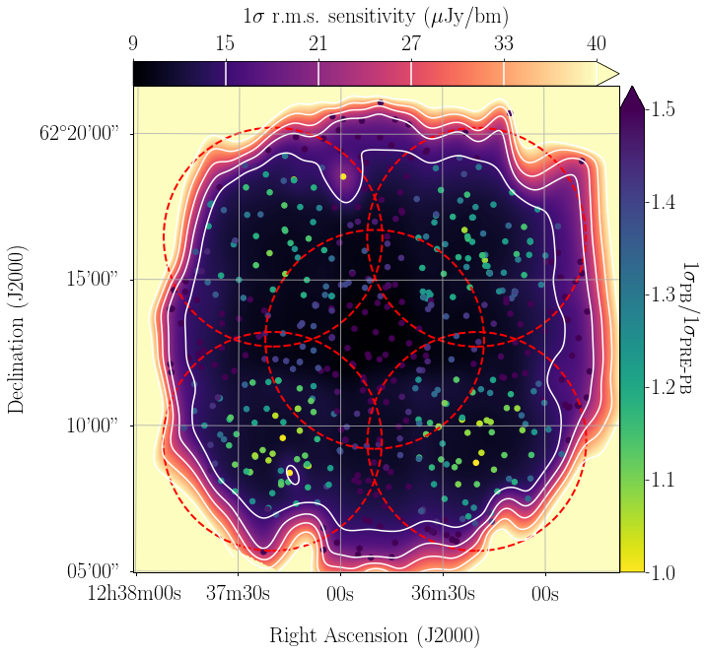
e-Merlin + EVN – In the SKA Era
High resolution high fidelity imaging
Large datasets
High powered computing
Sophisticated software packages
EG078 Epoch 1 – 24 hrs EVN 1.6GHz
Radcliffe+ - In Prep.
Epoch 3 includes e-Merlin baselines
- albeit with 1 bit sampling
EG078 Epoch 1 - 1σ=8.5µJy/bm
Full integration of wide-field EVN into the centimetric radio astronomy instruments to provide seamless imaging at angular resolution from 10s of arcseconds to milliarcseconds as part of a ‘World Telescope’ to image astronomical objects across all the angular scales
e-MERLIN+JVLA characterised with e-MERGE DR-1 in GOODS-N – Extending to include EVN with EG078 to image AGN/jet feedback embedded in extended starbursts…

Slide 16
e-MERGE 1.5GHz
DR-1 Release:
38 hrs JVLA (BW 1GHz)
127hrs e-MERLIN (BW 512MHz)
42 hrs VLA (BW 43.75MHz)
18 days Merlin (BW 15MHz)
20k x 20k image (15’ fov)
Beam 280x260mas
WSClean (mfs)
~820 sources
3.5 days for 1.06TB data with 150,000 cleans. 64core Intel Xeon v3 @ 2.3GHz
Muxlow, Smail, McHardy, Beswick, Wrigley, Thomson..
J123725+621128 S_{1.5} 5960µJy
Peak=236µJy/bm
Z=1.2653
Wide-Angled Tail
e-Merlin
GOODS-N L-Band DR-1
Central 5’ 1σ=1.49µJy/bm

Slide 17
e-MERGE 1.5GHz
DR-1 Release:
38 hrs JVLA (BW 1GHz)
127hrs e-MERLIN (BW 512MHz)
42 hrs VLA (BW 43.75MHz)
18 days Merlin (BW 15MHz)
20k x 20k image (15’ fov)
Beam 280x260mas
WSClean (mfs)
~820 sources
3.5 days for 1.06TB data with 150,000 cleans. 64core Intel Xeon v3 @ 2.3GHz
Muxlow, Smail, McHardy, Beswick, Wrigley, Thomson..
J123644+621133
S_{1.5}=1290µJy
Peak=488µJy/bm
Z=1.050
FR-I
e-Merlin
GOODS-N L-Band DR-1
Central 5’ 1σ=1.49µJy/bm

Slide 18
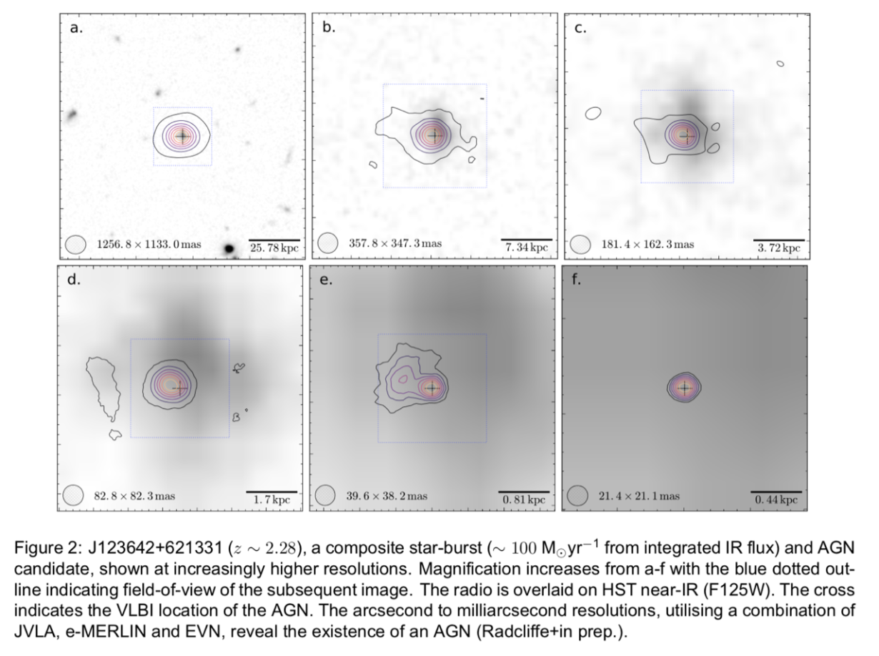
e-MERGE 1.5GHz
+EG078
DR-1 Release:
38 hrs JVLA (BW 1GHz)
127hrs e-MERLIN (BW 512MHz)
42 hrs VLA (BW 43.75MHz)
18 days Merlin (BW 15MHz)
+ 3x24hrs EVN (BW 128MHz)
20k x 20k image (15’ fov)
Beam 280x260mas
WSClean (mfs)
~820 sources
3.5 days for 1.06TB data with 150,000 cleans. 64core Intel Xeon v3 @ 2.3GHz
Muxlow, Smail, McHardy, Beswick, Wrigley, Thomson..
Garrett, Barthel, Deller, Radcliffe…
→Initial tests:
1st EG078 24hrs epoch
+ 46hrs e-Merlin+JVLA
J123642+621331 S_{1.5}=470µJy
Peak=236µJy/bm
CI=4.5µJy/bm
e-Merlin
GOODS-N L-Band DR-1
Central 5’ 1σ=1.49µJy/bm
e-Merlin + EVN integration → seamless imaging from arcsecond to mas scales

