Slide 1
JPL
DSCC VLBI PROCESSOR
(DVP)
J.E. Clark¹,
C. García-Miró², S. Horiuchi³
Jet Propulsion Laboratory, California Institute of Technology, USA
Madrid Deep Space Communications Complex, NASA, ISDEFE, Spain.
(3) Canberra DSN/NASA, C.S.I.R.O., Australia
Copyright 2014 California Institute of Technology.
U.S. Government sponsorship acknowledged.

Slide 2
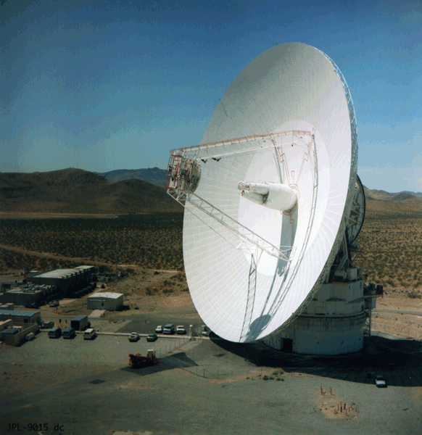
What is a DVP?
Current Implementation
Future Implementation
Fringes to antennas outside of DSN
DVP Specification Documentation
Questions?
Introduction

Slide 3
The DVP
One Mark5C
ROACH
Two-Input IF Digitizer
12x2 IF Switch
VEX in, VDIF out…

Slide 4
Operational Since December 2013
DVP CURRENT IMPLEMENTATION
Fixed 16 Complex Channels (I&Q) or…
Fixed 32 USB/LSB Channels
2, 4, or 8-bit Sampling
Up to 2Gb/sec Data Rate (No Dual-Bank)
VDIF Only (w/16-byte headers, I know…)
No WX, GPS-FMOUT, IFDTP, ANTAB, etc…
Operational VEX builder for JPL, dev version for others…

Slide 5
DVP FUTURE IMPLEMENTATION
Variable # Complex Channels (I&Q) or…
Variable # USB/LSB Channels
1, 2, 4, or 8-bit Sampling
Up to 4Gb/sec Data Rate (Dual-Bank)
VDIF Only (w/32-byte Headers)
WX, GPS-FMOUT, IFDTP, ANTAB, (PCFS-type Log File)
Single flexible VEX script builder for all users.
(Probably not until FY ’16)

Slide 6
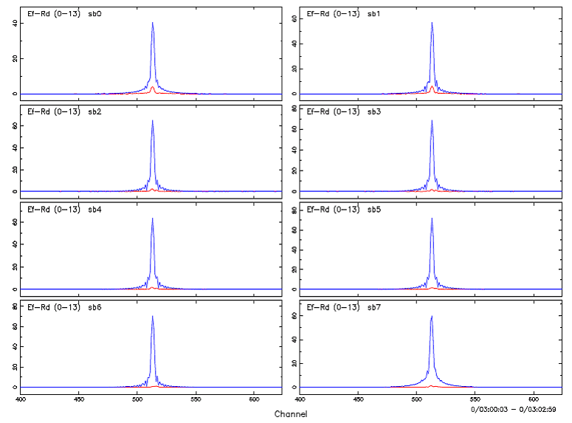
External DVP users: FRINGES
First Fringes!
DSS-63 at the EVN software correlator at JIVE (SFXC)
Effelsberg
To
Robledo DVP
8 channels,
16MHz wide,
2-bit

Slide 7
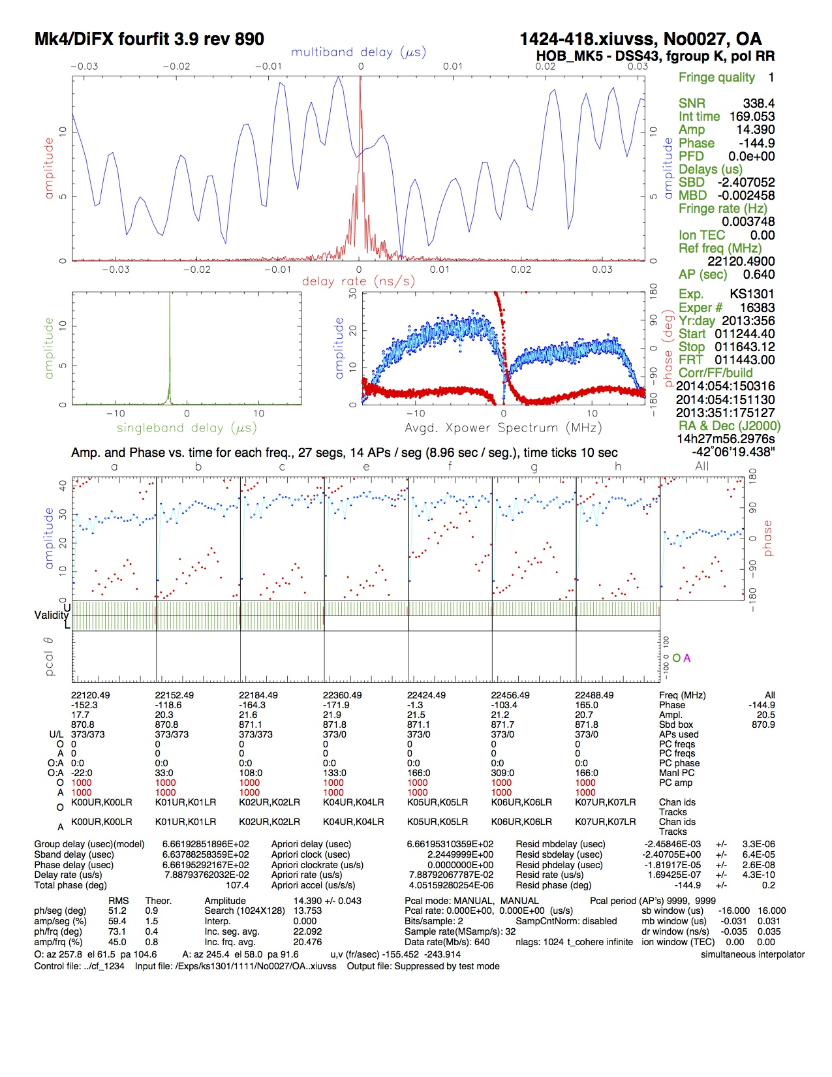
More Fringes…
DSS-43 22GHz Fringe test to HartRAO and Hobart, at BONN (DiFX) Correlator

Slide 8
More Fringes…
DSS-43 to Japanese VERA Antennas at Mitaka NAOJ…
IVS: DSS-65 for SGP EUR129 correlated at JIVE

Slide 9
For anyone interested:
JPL has published an official DVP External Interface Agreement. It describes the full specification and functionality of the DVP. I will make it available to any station.
Describes Input and output file formats, channel encoding, and data products from any DVP station in the Deep Space Network.

Slide 10
Questions?

