Slide 1
EVN Amplitude Calibration
Iván Agudo
Notes:
made to both chapters.

Slide 2
Quality of Calibration
Session 1/2014
=============================================================
Station 18cm 6cm 5cm 1.3cm
-------------------------------------------------------------
Ef 0.08(7) 0.05(12) 0.02(5) 0.10(2)
Jb1 0.12(7)* 0.23(10)*
Jb2 0.10(5) 0.22(2)*
Mc 0.13(6)* 0.03(12) 0.06(5) 0.10(2)
Nt 0.13(7)* 0.07(7) 0.22(2)* 0.26(1)*
On 0.18(7)* 0.07(11) 0.07(4) 0.37(2)*
Tr 0.16(7)* 0.03(7) 0.02(4) 0.35(2)*
Wb 0.06(7) 0.04(12) 0.05(4)
Ys 0.04(10) 0.03(5) 0.04(2)
Hh 0.08(4) 0.05(7) 0.29(1)*
Ur 0.26(6)* 0.07(11) 0.05(1)
Sh 0.13(6)* 0.07(10) 0.08(1) 0.16(2)
Bd 0.10(5) 0.04(5)
Zc 0.07(7) 0.09(10)
Sv 0.07(6) 0.05(11) 0.85(1)*
Ro 0.08(1)
Sr 0.17(1)* 1.13(1)*
Mh 1.04(1)*
Ku 0.13(1)
Kt 0.13(1)
Ky 0.18(1)
============================================================
Numbers here are the median absolute error in the antenna gain amplitude. This number will be approx half the error in the SEFD and is the same that you see in AIPS gain plots. The number in brackets after each entry is the number of experiments that were used to determine the median error for that entry.
EVN Amplitude Calibration, Iván Agudo (JIVE) EVN TOG Meeting, Cagliari, Italy, 06-10-2014

Slide 3
Quality of Calibration
Session 1/2014 (L-band):
Large amplitude errors in several stations. Probably artificial, slightly wrong calibration in Ef and Wb
Ef: Computed SEFD (9 -16) lower than the nominal one (19)
Wb: SEFD probably overestimated. Computed ~50-65, nominal one =40
Additional problems:
Ur: Tsys higher than normal. Perhaps something wrong with TCal calibration.
Sr: Test observations. Sensitivity loss in N14L1. Expected SEFD=38Jy, observed SEFD=49Jy. Also, dummy Tsys tables were used
EVN Amplitude Calibration, Iván Agudo (JIVE) EVN TOG Meeting, Cagliari, Italy, 06-10-2014

Slide 4
Quality of Calibration
Session 1/2014 (C-band): Mostly fine
Jb: Cal system failure in some user programs
Session 1/2014 (M-band): Mostly fine
Nt: RCP received broken since mid 2013. Station hopes to restore soon
Session 1/2014 (K-band):
Mh: Wrong calibration of DBBC. Problem solved for session II.
Sr: Test observations, N14K1. Fringes found but configuration of DBBC not optimum
Sv: Poor RCP sensitivity by a factor of ~2.5. Possible problem with LO sync
EVN Amplitude Calibration, Iván Agudo (JIVE) EVN TOG Meeting, Cagliari, Italy, 06-10-2014

Slide 5
Quality of Calibration
Session 1/2014 (K-band):
Jb: Dummy Tsys tables based on nominal SEFD
Nt: No good RCP data
Tr: Bad data on RCP IFs 7 and 8. Low amplitude on RCP IFs 1 and 2
Hh: Heavy rain
GENERAL NOTE:
Nominal SEFDs were used to make dummy Tsys tables for Bd, Sv, Zc and a significant number of observations by Jb.
These stations often suffer from larger amplitude calibration errors
EVN Amplitude Calibration, Iván Agudo (JIVE) EVN TOG Meeting, Cagliari, Italy, 06-10-2014

Slide 6
Quality of Calibration
Session 3/2013
=============================================================
Station 6cm 18cm 3.6cm 1.3cm
-------------------------------------------------------------
Ef 0.07(5) 0.07(6) 0.06(3) 0.13(3)
Jb1 0.08(5)
Jb2 1.44(3)*
Mc 0.02(5) 0.09(6) 0.06(4) 0.11(3)
Nt 0.18(5)* 0.14(5)* 0.23(3)*
On 0.07(4) 0.08(5) 0.23(4)* 0.38(3)*
Tr 0.04(2) 0.13(7) 0.16(3)
Wb 0.05(5) 0.04(7) 0.09(4)
Ys 0.09(5) 0.11(4) 0.05(3)
Hh 0.05(2) 0.06(3) 0.05(2) 0.12(1)
Ur 0.07(3) 0.18(4)* 0.20(2)* 0.18(3)
Sh 0.09(3) 0.20(4)* 0.21(2)
Bd 0.05(4) 0.07(6) 0.11(3) 0.55(3)*
Zc 0.15(4)* 0.06(5) 0.09(3) 0.16(3)
Sv 0.24(5)* 0.05(5) 0.15(3)* 0.07(3)
Ar 0.04(2)
Ro 0.06(1)
============================================================
Numbers here are the median absolute error in the antenna gain amplitude. This number will be approx half the error in the SEFD and is the same that you see in AIPS gain plots. The number in brackets after each entry is the number of experiments that were used to determine the median error for that entry.
EVN Amplitude Calibration, Iván Agudo (JIVE) EVN TOG Meeting, Cagliari, Italy, 06-10-2014

Slide 7
Quality of Calibration
Session 3/2014 (C-band):
Sv: LCP receiver warm on some user programs. Sensitivities at LCP clearly affected
Nt: Low sensitivity on LCP (more prominent on subbands 7 and 8)
Zc: Self-calibration gains ~0.85
Session 3/2014 (L-band):
Sh: Low sensitivity both RCP and LCP. Self calibration gains ~1.13 to ~1.19
Nt: Self-calibration gains on LCP and RCP ~0.90 to 0.77.
Ur: Variable self-calibration gains from 2 to 0.7. Strong RFI in the whole bandpass
EVN Amplitude Calibration, Iván Agudo (JIVE) EVN TOG Meeting, Cagliari, Italy, 06-10-2014

Slide 8
Quality of Calibration
Session 3/2014 (X-band):
Ur: LCP sub-bands 7 and 8 dominate amplitude errors (gains up to 2.2). Receiver specs may not meet astronomical requirements (being investigated)
On: Over-high amplitude caused by over-narrow DBBC 16MHz filter (valid bandwidth 13 MHz) and DBBC power sampling outside of the linear region (solved)
Sv: LCP receiver affected by low sensitivity. Self-calibration gains to ~1.25 to ~1.35
Session 3/2014 (K-band):
Jb: No optimum .rxg files for appropriate amplitude calibration. No K-band .rxg file generated.
On: Over-high amplitude caused by over-narrow DBBC 16MHz filter (valid bandwidth 13 MHz) and DBBC power sampling outside of the linear region (solved)
Bd: Low sensitivity. Self-calibration gains by ~1.8 to ~1.5
Nt: No good RCP data. LCP self-calibration gains were ~0.92 to ~0.59, plausibly produced by degradation of the receivers.
EVN Amplitude Calibration, Iván Agudo (JIVE) EVN TOG Meeting, Cagliari, Italy, 06-10-2014

Slide 9
Quality of Calibration
AGAIN, GENERAL NOTE:
Nominal SEFDs were used to make dummy Tsys tables for Bd, Sv, Zc and a significant number of observations by Jb.
These stations often suffer from larger amplitude calibration errors
These and other problems related to non optimum Tsys calibration tables:
MAKES ONE OF THE MAIN WEAKNESSES OF THE EVN!
EVN Amplitude Calibration, Iván Agudo (JIVE) EVN TOG Meeting, Cagliari, Italy, 06-10-2014

Slide 10
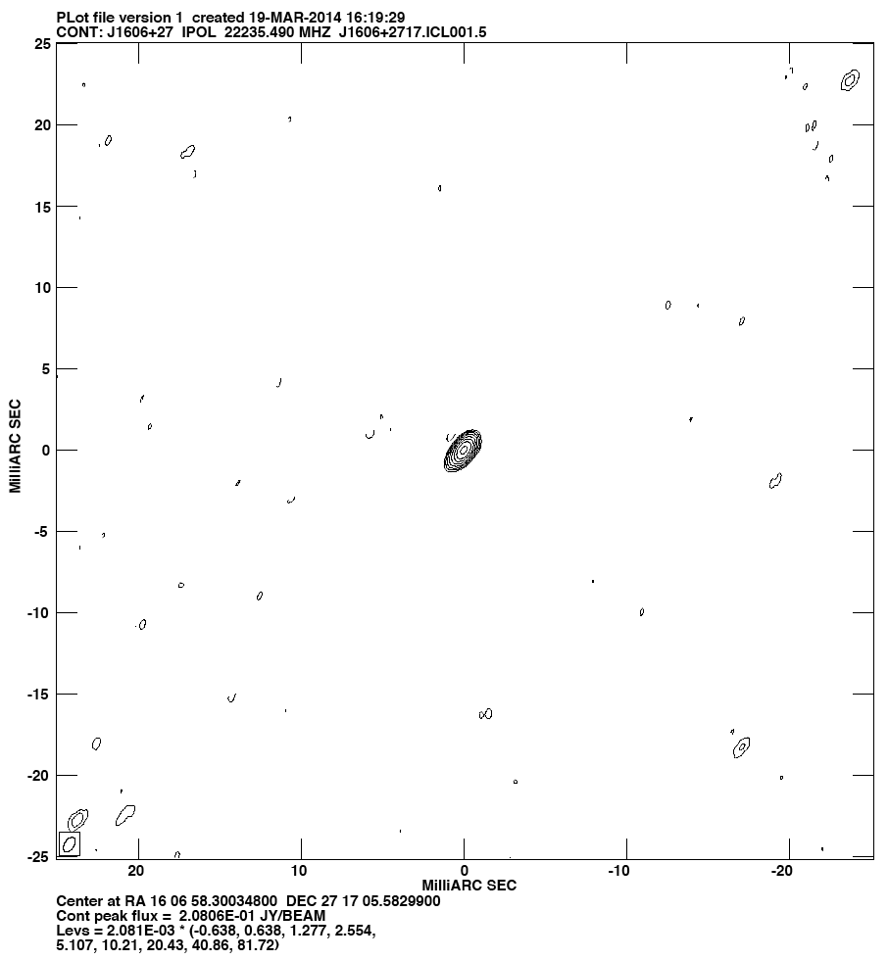
Quality of Calibration
K-band
Full track of Ef Jb On Mc Nt Tr Ys Mh Sv Zc Bd Ur Sh
Tsys measurements for ALL stations but Jb, Sv, Zc, and Bd
rms ~1.3 mJy/beam
EVN Amplitude Calibration, Iván Agudo (JIVE) EVN TOG Meeting, Cagliari, Italy, 06-10-2014

Slide 11
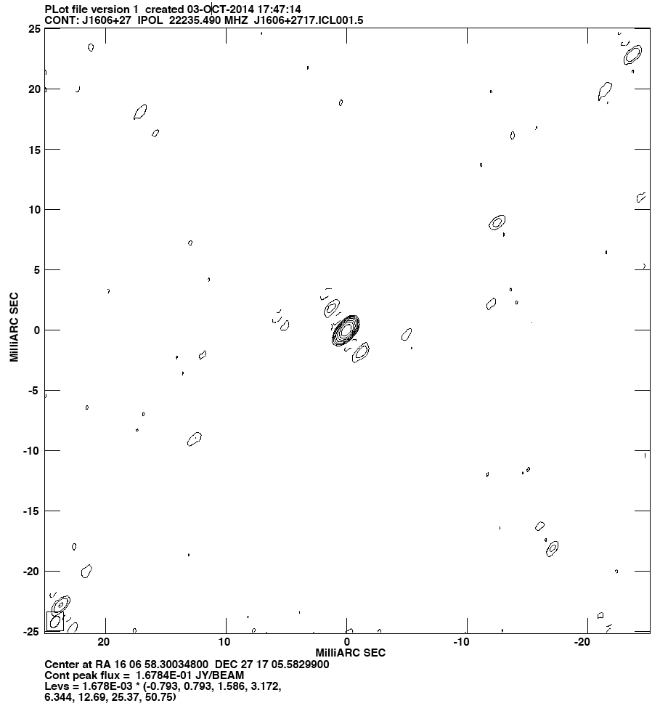
Quality of Calibration
K-band
Full track of Ef Jb On Mc Nt Tr Ys Mh Sv Zc Bd Ur Sh
Tsys measurements only for Ef & Ys
rms ~1.3 mJy/beam
Total flux density scale differs by ~ 20%
Clear amplitude calibration errors appear as strong side-lobes
May lead to non detections in weak sources
BAD
EVN Amplitude Calibration, Iván Agudo (JIVE) EVN TOG Meeting, Cagliari, Italy, 06-10-2014

Slide 12
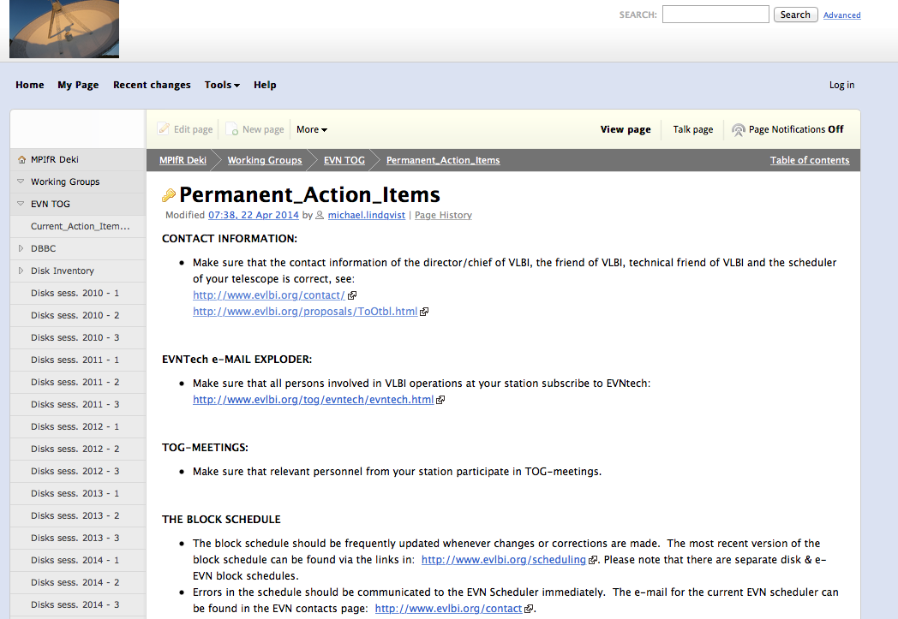
Timely delivery of ANTAB-files
Now described in the list of Permanent Action Items (now a merge of the Bologna Rules and the previous Permanent Action Items):
https://deki.mpifr-bonn.mpg.de/Working_Groups/EVN_TOG/Permanent_Action_Items
EVN Amplitude Calibration, Iván Agudo (JIVE) EVN TOG Meeting, Cagliari, Italy, 06-10-2014

Slide 13
Timely delivery of ANTAB-files
Now described in the list of Permanent Action Items (now a merge of the Bologna Rules and the previous Permanent Action Items):
https://deki.mpifr-bonn.mpg.de/Working_Groups/EVN_TOG/Permanent_Action_Items
In particular:
"Stations must aim to produce ANTABFS-, UVFLG- and RXG-files within 2 weeks after the end of a session.”
"ANTABFS files for eVLBI experiments should be produced as soon as possible (< 24 hours after the experiment)"
Timely delivery can significantly speed up correlation (if no delays on uploading log files), post review, and pipeline processes
Make more disk packs be available in the upcoming session.
Automatically uploading log files and gps data are very welcome
EVN Amplitude Calibration, Iván Agudo (JIVE) EVN TOG Meeting, Cagliari, Italy, 06-10-2014

Slide 14
antabfs.pl Script
Major updates since last TOG meeting:
Feb 19, 2014: Update for e-VLBI stations using FS-9.11.5 version or later
Thanks Jonathan Quick!
Needed for stations doing e-VLBI with a Mark5B (or B+) recorder, regardless of whether they are using a DBBC or analogue (Mk5) terminal
If you need an update, ask Jonathan or me.
EVN Amplitude Calibration, Iván Agudo (JIVE) EVN TOG Meeting, Cagliari, Italy, 06-10-2014

