Slide 1
Mm VLBI with ALMA
Zulema Abraham
University of São Paulo
Brazil

Slide 2
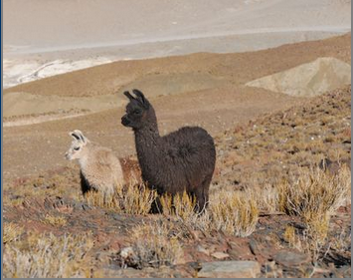
Outline
The LLAMA project
LLAMA stands for Large Latin American Millimeter Array. It is a joint Bazilian-Argentinian project
The idea is to install several (at least two) radiotelescopes at a distance of hundreds of kilometers from ALMA to perform VLBI observations and extend ALMA resolution by a factor of 10

Slide 3
Executive Board
Argentina
Marcelo Arnal (IAR)
Ricardo Morras (IAR)
Juan José Larralde (IAR)
Carlos Viramonte (University of Salta)
Brazil
Jacques Lépine (USP)
Elizabete Dal Pino (USP)
Guillermo Gimenez de Castro (Mackenzie University)
Zulema Abraham (USP)

Slide 4
LLAMA
For the time being it consists of a single 12 m ALMA type antenna. It is built by VERTEX and will be delivered at the beginning of 2016.
It will be installed in the Argentinian side of the Atacama desert, at an altitude of about 4800 m.
It will operate at frequencies between 40 and 800 GHz

Slide 5
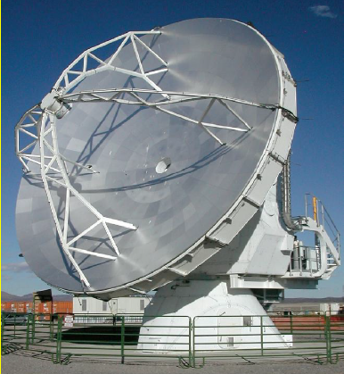
APEX ALMA

Slide 6
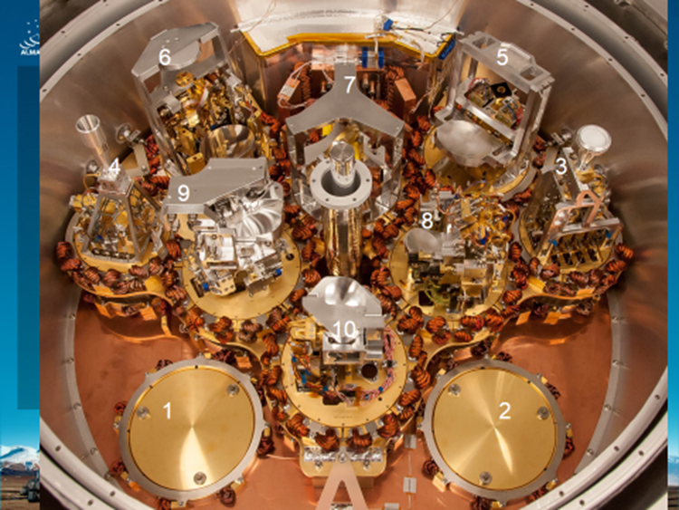
ALMA receivers (T = 4K)

Slide 7
Proposed Cryostats (NOAJ)

Slide 8
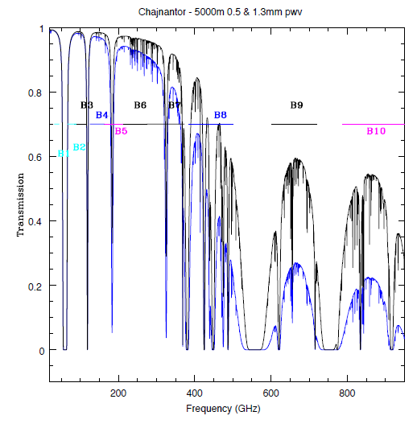
Observing bands of ALMA

Slide 9
The receivers

Slide 10
Who builds them

Slide 11
The site

Slide 12
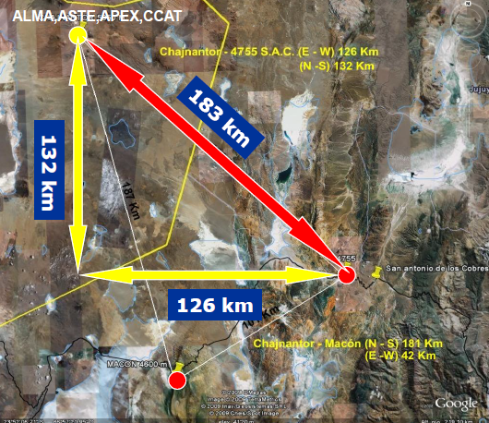

Slide 13
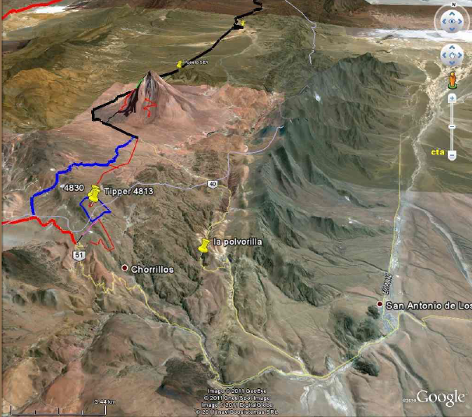

Slide 14
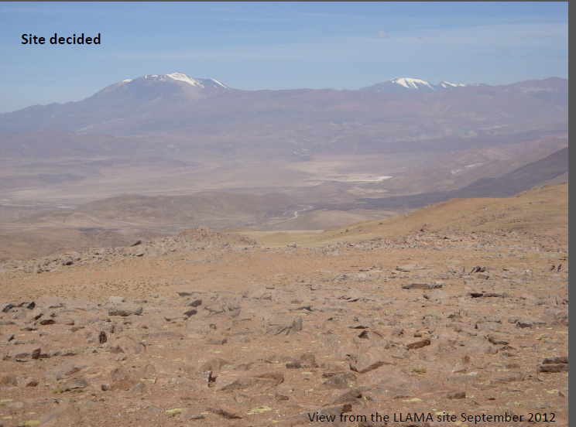

Slide 15
Funding and organization
Brazil is paying for the antenna, the cryostats and some of the receivers
Argentina provides the infrastructure
Funding for VLBI?
The observing time will be divided between the two countries. Time will be reserved for the international community and other collaborators.
One of the uses will be to test new receivers and systems.

Slide 16
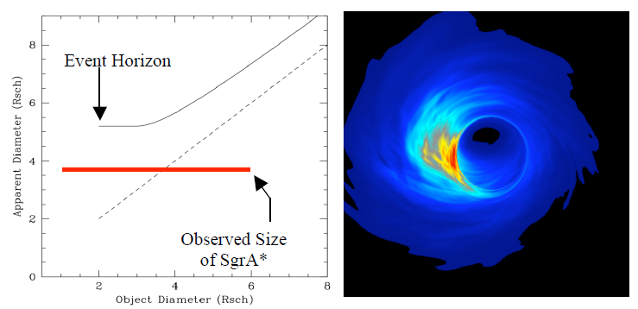
Science with LLAMA: Shadow of the BH at the GC
Observed size should be larger than real size due to gravitational lensing
Actual observed size is smaller than expected, because emission does not come from the center, but from the beamed front region (Falke & Markoff 2000)

Slide 17
FAPESP Workshop 2011
High resolution observations of AGNs (Thaisa Stochi Bergman, UFRGS)
Astrophysical jets and protostelar cores (Elisabete de Gouveia dal Pino, IAG/USP)
Micro-quasars (Gustavo Romero, IAR, Argentina)
Structure of the first galaxies in the Universe (Laerte Sodre, IAG/USP)

Slide 18
FAPESP Workshop 2011
CO mapping of the spiral structure of galaxies (Horacio Dottori, UFRGS)
Cold structures in the interstellar medium (Diego Falceta-Gonçalves, IACH/USP
Supernova remnants and molecular clouds (Gloria Dubner, IAFE, Argentina)
Astrophysical masers (Zulema Abraham, IAG/USP)

Slide 19
FAPESP Workshop 2011
Polarization studies with LLAMA (Antonio Mario Magalhães, IAG/USP)
Solar Physics with LLAMA (Pierre Kaufmann, Mackenzie)
Observation of Exoplanets with LLAMA and ALMA (Adriana Valio, Mackenzie)
Organic Molecules of interest for life (Claudia Lage, UFRJ)
Astrometry with LLAMA (Ramakrishna Teixeira, IAG/USP)

