Slide 1
EVN Performance and Reliability
Iván Agudo
Notes:
made to both chapters.

Slide 2
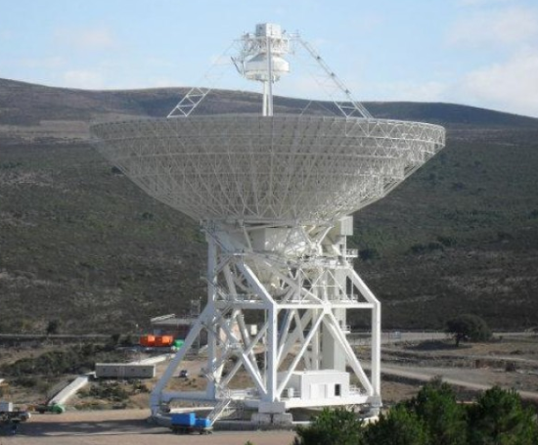
Collection of Highlights
A large improvement of the EVN in terms of new stations & sensitivity!
Sardinia Radio Telescope (SRT)
First fringes at 22 GHz on 27/01/2014
SRT – Medicina
SRT participated as an EVN station on EVN session 1-2014
Test at 18, 5, and 1.3 cm.
Fringes were found at 18 and 1.3cm.
Congratulations!
EVN Amplitude Calibration, Iván Agudo (JIVE) EVN TOG Meeting, Cagliari, Italy, 06-10-2014

Slide 3
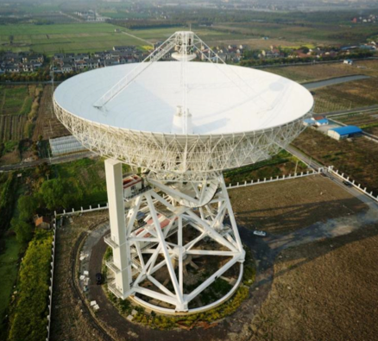
Collection of Highlights
A large improvement of the EVN in terms of new stations & sensitivity!
The 65m new radio telescope in Shanghai, Tian Ma 65:
Participated on all EVN session 1-2014 tests at 18, 6 and 5cm.
Fringes found all these bands both
Tian Ma 65 is now offered as an EVN Station (see EVN Status Table).
Congratulations!
EVN Amplitude Calibration, Iván Agudo (JIVE) EVN TOG Meeting, Cagliari, Italy, 06-10-2014

Slide 4
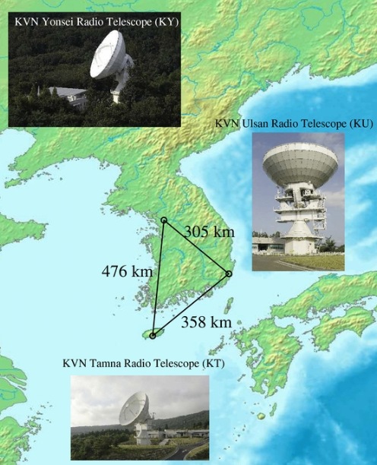
Collection of Highlights
A large improvement of the EVN in terms of new stations & sensitivity!
ALL three stations of the Korean VLBI Network
Joined the EVN array as regular EVN stations
They participate in all tests at K & Q bands
Started to participate in user experiments from 2014-2 session.
KVN now offered as EVN Stations.
EVN Amplitude Calibration, Iván Agudo (JIVE) EVN TOG Meeting, Cagliari, Italy, 06-10-2014

Slide 5
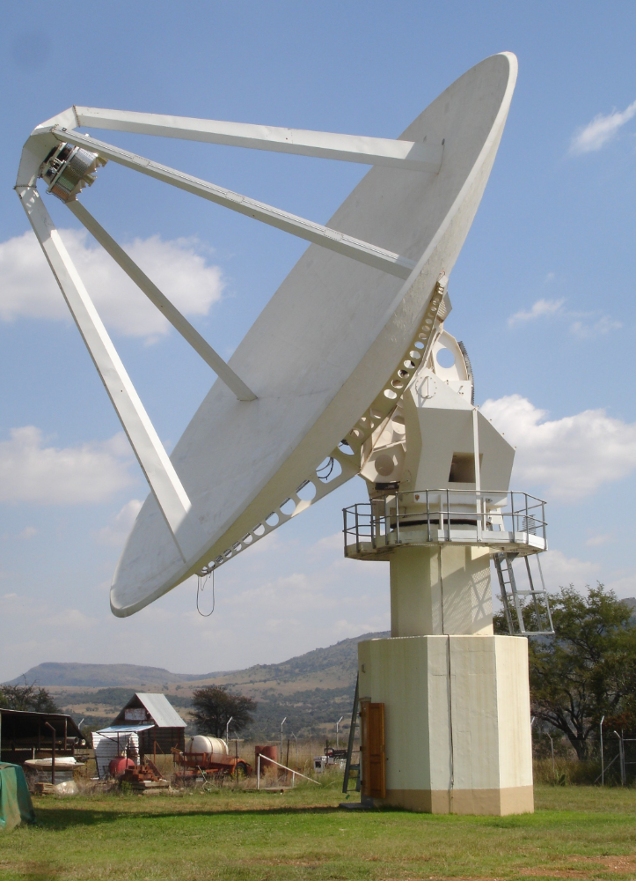
Collection of Highlights
A large improvement of the EVN in terms of new stations & sensitivity!
15m station has been made recently available at Hartebeesthoek (SA).
15m station has been made recently available at Hartebeesthoek (SA).
This stations is currently limited to observations at 13 and 3.6cm
For limited periods of time
Ht now offered as an EVN Station.
EVN Amplitude Calibration, Iván Agudo (JIVE) EVN TOG Meeting, Cagliari, Italy, 06-10-2014

Slide 6
Collection of Highlights
Backends
Ef, On, Ys, Nt, Tr, and Hh using DBBCs, standard in 2014-3 session. Mc still needs tests
Ro now uses new DVP (NASA/JPL developed digital) backend (EVN compatible ANTABFS tables produced routinely)
Other highlights
Data from two EVN and one Global programs involving space VLBI with Radioastron correlated at Astro Space Centre correlator, Moscow (session 3/2013)
First e-VLBI user program at K-band successful involving Eb, Jb2, On20, Mc, Nt, Tr, Sh, Ys, and Mh)
EVN Amplitude Calibration, Iván Agudo (JIVE) EVN TOG Meeting, Cagliari, Italy, 06-10-2014

Slide 7
NME Results & Feedback from user experiments: Session 2014-2 (an advance)
P band:
Jb: Strong crosstalk between polarisations on N14P1
M-band:
On: A fuse for declination motor broke repeatedly. 3 user programs lost at M-band
K band:
Jb: No fringes. Receiver failure
Kt: No data received. 8-pack has no data on it for user experiments as well
Q band:
Nt: Wrong frequency set. No fringes
EVN Amplitude Calibration, Iván Agudo (JIVE) EVN TOG Meeting, Cagliari, Italy, 06-10-2014

Slide 8
NME Results & Feedback from user experiments: Session 2014-1
L band:
Sv: Data from F14L1, EM111 were accidentally deleted by the operator
C band:
Tr: No fringes in much of the session (mis-set of the first LO by 100 MHz)
K band:
Nt: no useful RCP data
Sv: no fringe solutions in RCP
Bd: no data received at JIVE. A disk-pack got lost in shipping
Mh: no good data. Station reports a problem with calibration of DBBC
General issues:
Jb: No feedback provided for the entire session
Tr: No fringes on BBC7, which was unlocked, for apparently the entire session.
EVN Amplitude Calibration, Iván Agudo (JIVE) EVN TOG Meeting, Cagliari, Italy, 06-10-2014

Slide 9
NME Results & Feedback from user experiments: Session 2013-3
L band:
Jb: No fringes with Jb for all L-band observations. Reason unknown
K band:
Mh: LCP channel broken, but no fringes either in RCP for the entire session
Nt: only had LCP data available
General:
Tr: BBC07 unlocked. Two RCP subbands 7 and 8 lost because of that. Antenna control failure during 3 user experiments. Recorder did not work for one more of them
On: Did not observe for ~8-9 experiments because of high wind
Ur and Sh lost ~3 user programs because of participation in China Chang E obs
EVN Amplitude Calibration, Iván Agudo (JIVE) EVN TOG Meeting, Cagliari, Italy, 06-10-2014

Slide 10
Other notes
Notes on Sampler Statistics:
Has been monitored by the ftp fringe tests since session 1/2010.
Van Vleck correction is done by JIVE software correlator SFXC.
Channels with poor sampler statistics were less (almost not) seen specially because the predominant use of digital backends.
REMINDER on pre-session checks:
Make in contact with JIVE support scientist by Skype before start of session (for feedback and to solve potential problems on the fly)
Contact info usually included on FTP-FT schedules
NOTE for K & Q band observations:
Please, include basic-general weather information (i.e. clouds/rain/wind) on feedback page. It helps to understand problems during data reduction
EVN Amplitude Calibration, Iván Agudo (JIVE) EVN TOG Meeting, Cagliari, Italy, 06-10-2014

