Slide 1
VGOS GPU Based Software Correlator Design
Igor Surkis, Voytsekh Ken, Vladimir Mishin,
Nadezhda Mishina, Yana Kurdubova, Violet Shantyr, Vladimir Zimovsky
Institute of Applied Astronomy, RAS
St. Petersburg, Russia
Third International VLBI Technology Workshop 10 - 13 November 2014, Groningen/Dwingeloo, the Netherlands

Slide 2
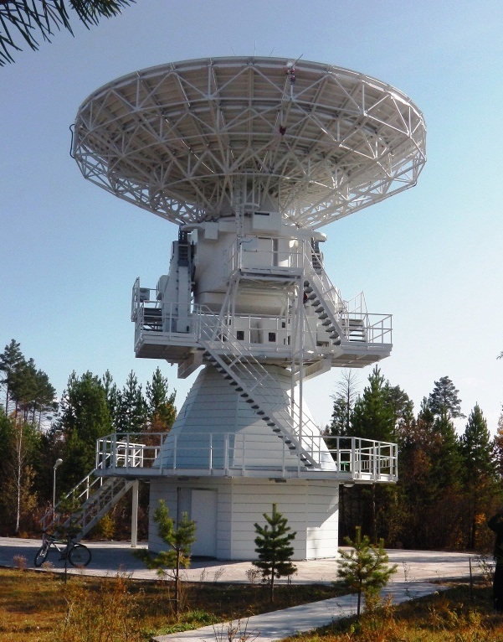
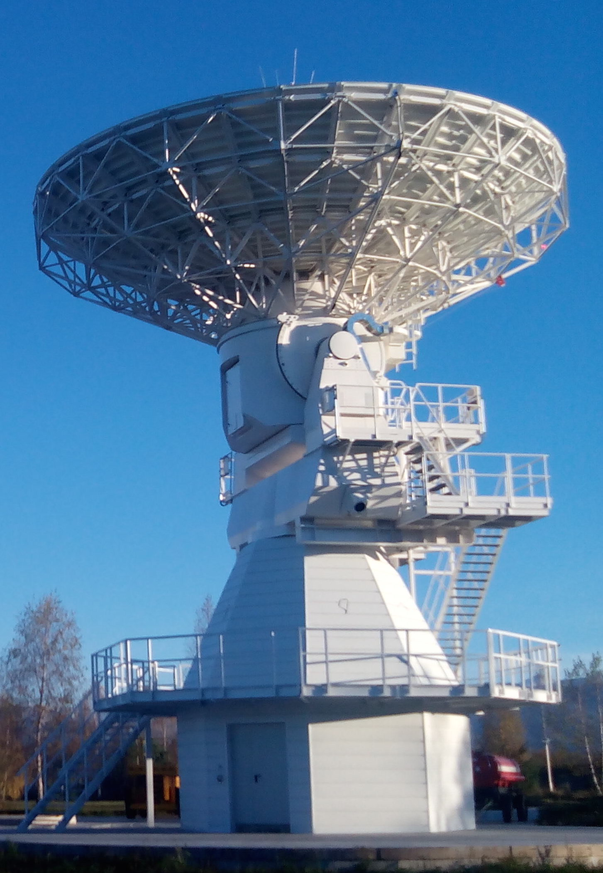
Introduction
Specifications
Main design ideas
Basic modules
HPC cluster
Topology
Station module
Correlation module
Benchmarks
First fringe
Future plans
Badary and Zelenchukskaya VGOS antennas of “Quasar” VLBI network
Third International VLBI Technology Workshop 10 - 13 November 2014, Groningen/Dwingeloo, the Netherlands

Slide 3
Correlator Specification
Input data stream of up to 16 Gbps from each of up to 6 observatories:
2-bit sampling
4 frequency bands:
2 polarizations, 512 MHz bandwidth
1 polarization, 1024 MHz bandwidth
VDIF data format
Cross-spectra resolution of up to 4096 spectral channels
(near-real time)
Extracting 32 phase calibration tones (near-real time)
Third International VLBI Technology Workshop 10 - 13 November 2014, Groningen/Dwingeloo, the Netherlands

Slide 4
Main Design Ideas
The new correlator is a FX software one
The basic principles comes from the correlator DiFX ideas
The main distinctive feature is using Graphical Processing Units (GPUs) for the most computations, because GPU is equipped with hundreds of computing cores, and mathematical algorithms can be parallelized – less processing units, less traffic between modules
Hardware is based on the hybrid blade servers (CPU+GPU) in the high-perfomance computing cluster
Third International VLBI Technology Workshop 10 - 13 November 2014, Groningen/Dwingeloo, the Netherlands

Slide 5
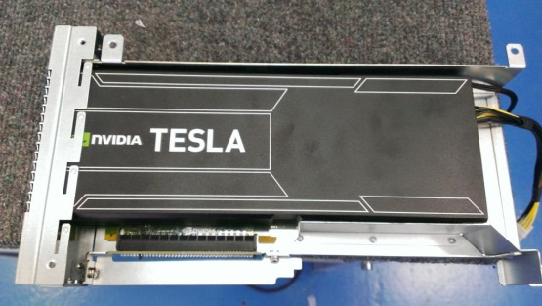
Basic Modules
Station module:
Input stream decoding
Delay tracking
Phase calibration signal extraction
Data synchronization
Bits repacking
Correlation module:
Bits transformation
Fringe rotation
Auto- and cross-correlation spectra processing
Head module:
Interblock processes control
Results collecting
Spectus 2U cache server / V200F CM:
station module / correlation module
CPU: 2 Intel E5-2670, 8-core, 2.6 GHz
GPU: 2 NVIDIA Tesla K20
RAM: 256 GB / 64 GB
Network interfaces: 2x10 Gb Ethernet, 56 Gbps Infiniband / 56 Gbps Infiniband
Third International VLBI Technology Workshop 10 - 13 November 2014, Groningen/Dwingeloo, the Netherlands

Slide 6
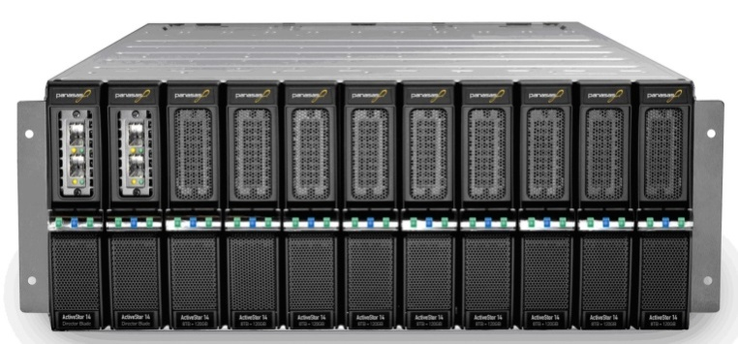
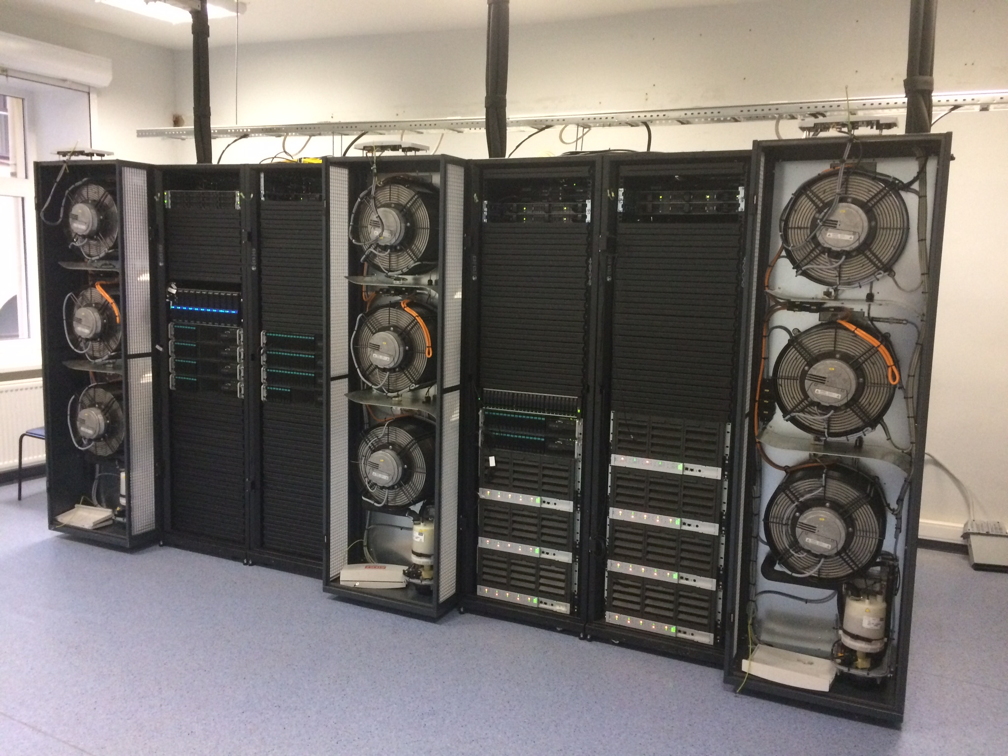
High-Performance Computing Cluster
Panasas 75 TB Pan-FS storage solution
Melanox 56 Gbps Infiniband network
8 Cache servers, 32 V200F compute modules, appropriate power supply and cooling system forms IAA RAS HPC cluster with total peak performance of 85.5 Tflops
Third International VLBI Technology Workshop 10 - 13 November 2014, Groningen/Dwingeloo, the Netherlands
Notes:
Кол-во серверов, инфинибэнд, СХД. Как все с вместе работает.

Slide 7
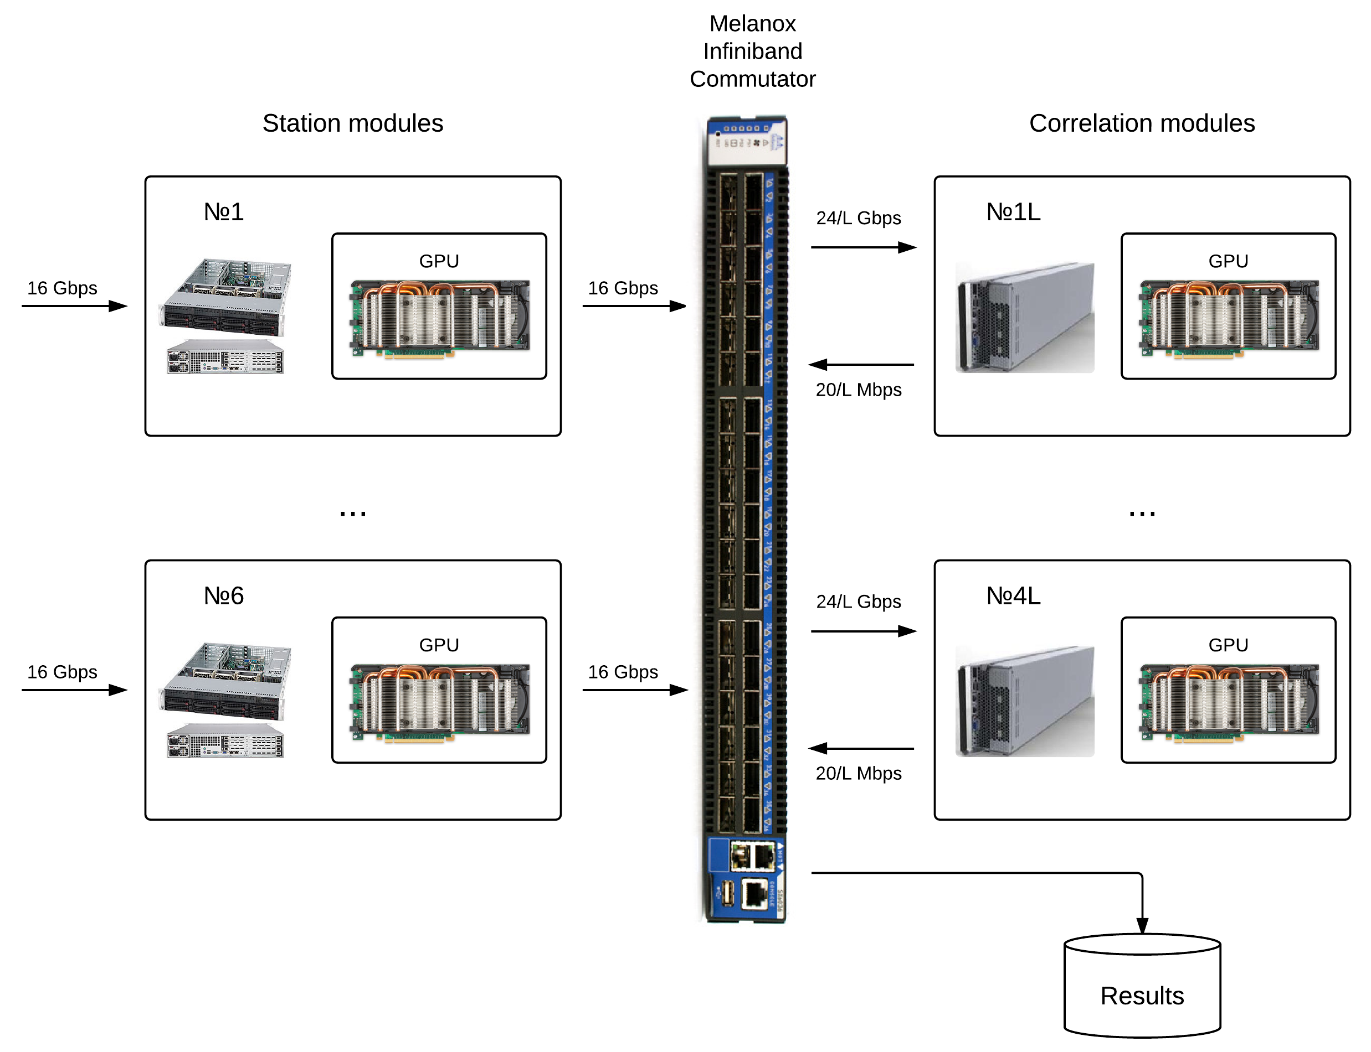
Correlator Topology
Third International VLBI Technology Workshop 10 - 13 November 2014, Groningen/Dwingeloo, the Netherlands

Slide 8
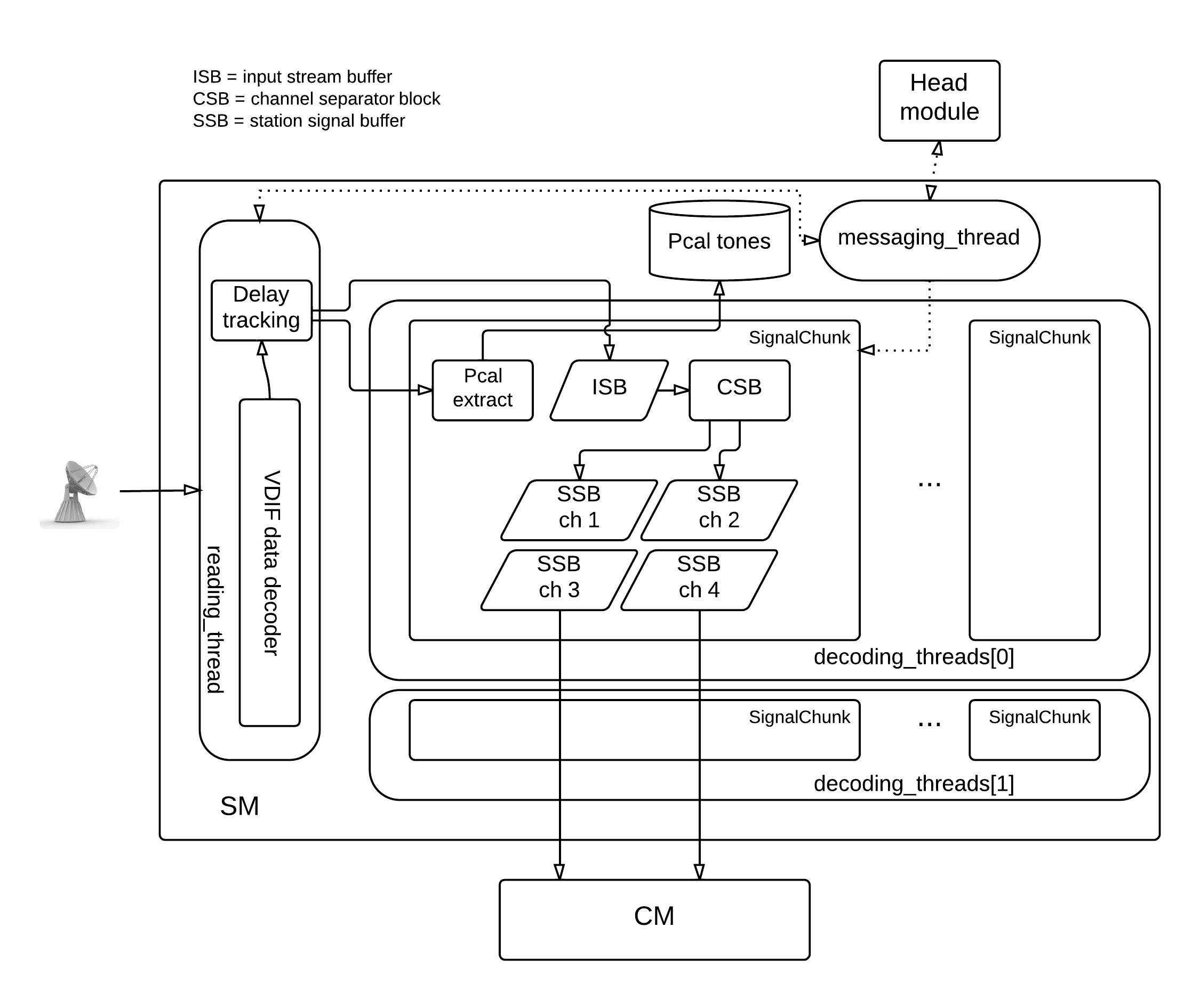
Station Module
Third International VLBI Technology Workshop 10 - 13 November 2014, Groningen/Dwingeloo, the Netherlands

Slide 9
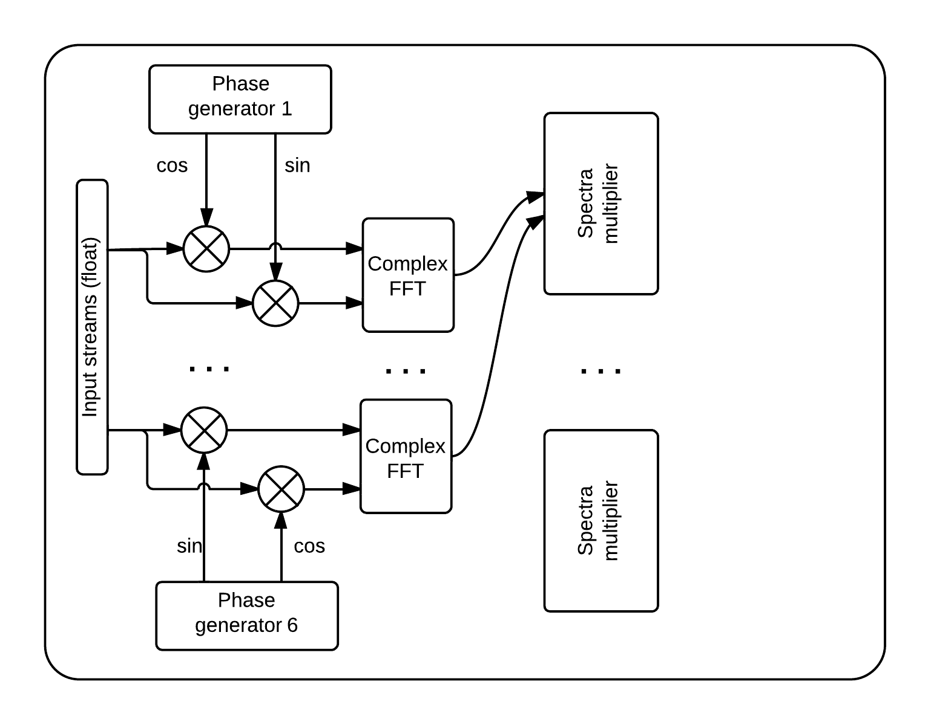
Correlation Module
Cross-correlation algorithm
Cross-correlation is done for all stations and all polarizations including auto-correlation generating 78 spectra for 6 stations 2 polarizations.
9
Third International VLBI Technology Workshop 10 - 13 November 2014, Groningen/Dwingeloo, the Netherlands

Slide 10
Station Module Benchmarking
Time benchmarking for SM data processing of 1 sec 16 Gbps (8-channel, 2-bit)
Operation | Tesla K20X (Kepler)
Reading & delay tracking | 0.98 s
Buffer repacking | 0.32 s
Pcal repacking | 0.21 s
Pcal reduction | 0.19 s
Performance of station module is enough for accomplishing the required operations
Third International VLBI Technology Workshop 10 - 13 November 2014, Groningen/Dwingeloo, the Netherlands

Slide 11
Correlation Module Benchmarking
Time benchmarking for 2-station processing of 64 million samples
Operation | Tesla K20X (Kepler)
Bits unpacking and fringe rotation | 23 ms (22 GBps)
FFT | 6.5 ms (154 GBps)
Spectra multiplication | 6.6 ms (150 GBps)
These algorithms require 7 Kepler K20x blades for near-real time processing of one wideband (512 MHz, 2 Gbps) data stream
Third International VLBI Technology Workshop 10 - 13 November 2014, Groningen/Dwingeloo, the Netherlands
Notes:
Первые два значения для станции, последнее для базы. Первые два знач-я 2х. Последнее 3х для всех вариантов кросс-спетров.

Slide 12
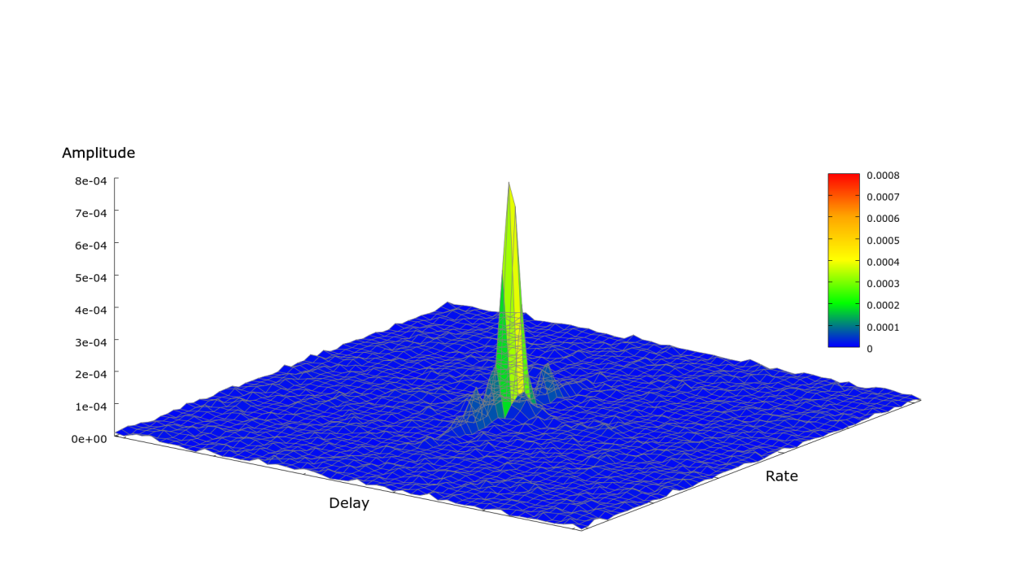
First Fringe
Fringe fitting results for the scan of source 1300+580 performed with BRoadband Acquisition System (BRAS) during RUTest-074 series
Third International VLBI Technology Workshop 10 - 13 November 2014, Groningen/Dwingeloo, the Netherlands

Slide 13
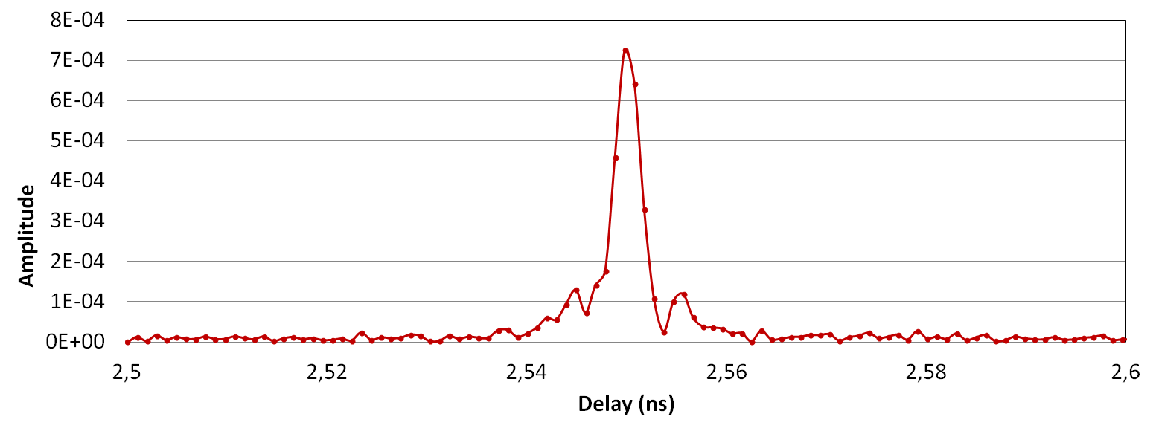
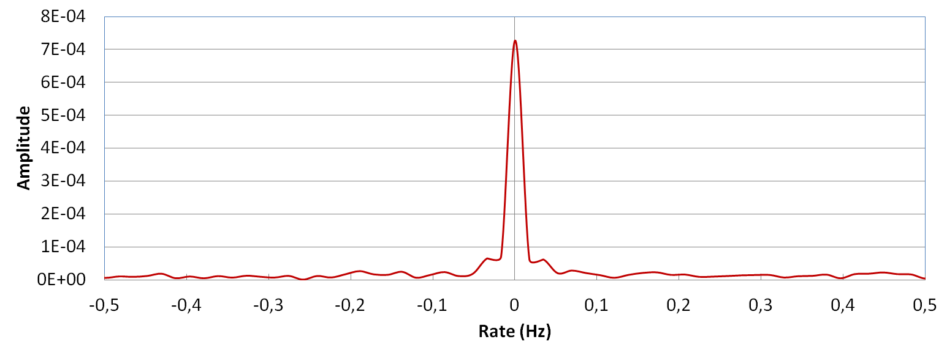
First Fringe
Fringe fitting results for the scan of source 1300+580 performed with BRoadband Acquisition System (BRAS) during RUTest-074 series
Third International VLBI Technology Workshop 10 - 13 November 2014, Groningen/Dwingeloo, the Netherlands

Slide 14
Future Plans
Late 2014:
Benchmark tests with maximum data rate (6-stations) in IAA RAS
2015:
Final stage of control & GUI software developing and testing
Post-processing system software developing and testing
Regular observations of “Quasar” VLBI network processing
Third International VLBI Technology Workshop 10 - 13 November 2014, Groningen/Dwingeloo, the Netherlands

Slide 15
Thank you!

